Slide 1

Slime Lab
{Pictures of slime}

Slide 2
How is slime made?
Slime is made through a chemical reaction between polyvinyl alcohol (or other polymer with alcohol containing chains that react with boron ions) and borate ions
Weak ionic bonds between the alcohol groups of the polymer and the borate ions are formed
Polyvinyl alcohol
Sodium Tetraborate

Slide 3
How does the concentration of ions affect the properties of the slime?
{Specific chemical reaction using, reagent dependent or other graphic}

Slide 4
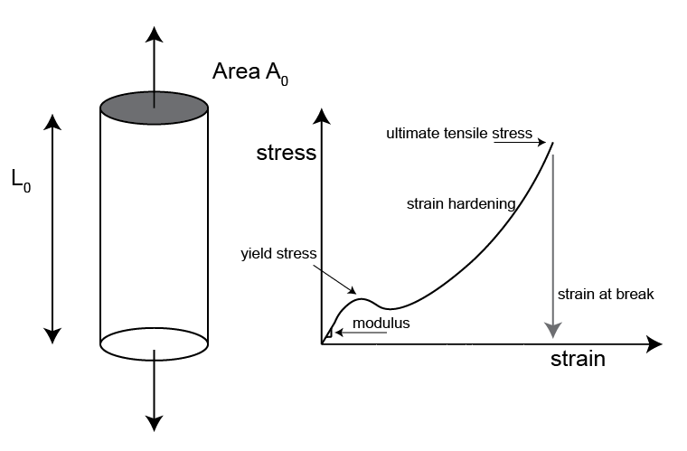
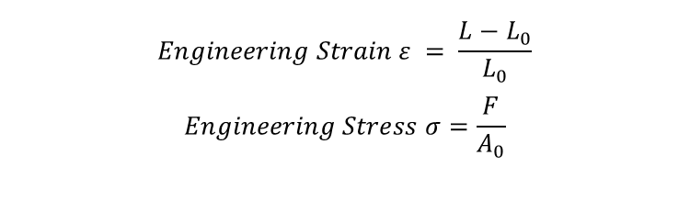
Stress – Strain Diagram and Calculations
$$Engineering Strain ε = \frac{L−L_{0}}{L_{0}}$$
$$Engineering Stress σ=\frac{F}{A_{0}}$$

